Slide 1
Artificial Intelligence (AI)
Time and Space Complexity for Search Algorithm

Slide 2
Agenda
Time and Space Complexity for Search Algorithms
Learning Outcomes : Application of Time and Space Complexity for Search Algorithms
Methodology and Assessment Criteria for the Subject

Slide 3
Complexity : An Introduction
Complexity is defined as the running time to execute a process and it depends on space as well as time.
Space Complexity
Time Complexity

Slide 4
Complexity : A Basic Operation
Basic operation means the main operation that will be required to solve particular problem. For example the basic operation in searching is comparison. The complexity depends on the basic operation.
The focus to determine the cost is done on running time i.e time complexity and it depends on the following factors
Size of Input Data
Hardware
Operating System
Programming Language used

Slide 5
Space Complexity
The amount of computer memory required to solve the given problem of particular size is called as space complexity. The space complexity depends on two components:
Fixed Part - It is needed for instruction space i.e byte code, variable space, constants space etc.
Variable Part - Instance of input and output data.
Space(S) = Fixed Part + Variable Part

Slide 6
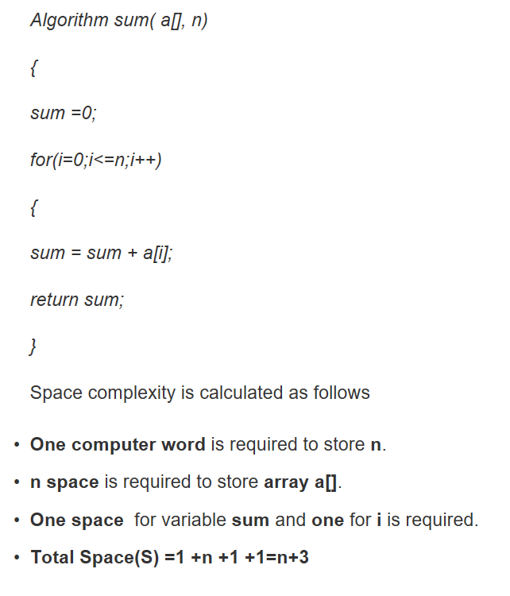
An Example

Slide 7
Time Complexity
The time required to analyze the given problem of particular size is known as the time complexity. It depends on two components:
Fixed Part - Compile time
Variable Part - Run time dependent on problem instance. Run time is considered usually and compile time is ignored.

Slide 8
Ways to Count Time Complexity
Use a stop watch and time is obtained in seconds or milliseconds.
Step Count - Count no of program steps.
Comments are not evaluated so they are not considered as program step.
In while loop steps are equal to the number of times loop gets executed.
In for loop, steps are equal to number of times an expression is checked for condition.
A single expression is considered as a single step. Example a+f+r+w+w/q-d-f is one step.
Rate of Growth(Asymptotic Notations)

Slide 9
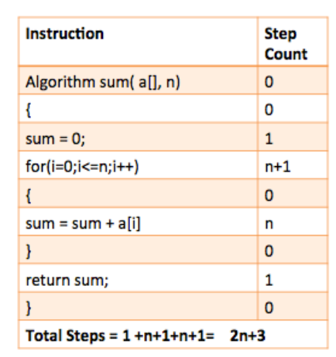
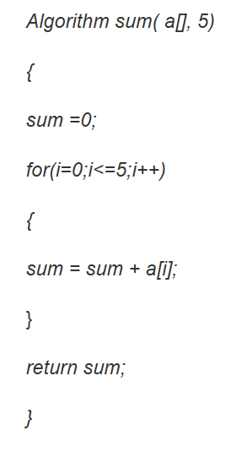
Example of Step Count
Notes:
Step count is a difficult approach if we need to compare results. For example: If we used two techniques to solve one problem and T(1) is the running time of first technique and T(2) is the running time of second technique. Say T(1) =( n+1 )and T(2) is (n² + 1). We cannot decide which one is the better solution,so for comparisons 'Rate of growth' i.e. asymptotic notations of time space complexity functions are much convenient to use.

Slide 10
Asymptotic Notation
These notations gives the rate of growth. Instead of dealing with exact expressions we deal with asymptotic behavior. Asymptotic means to approach a value or curve arbitrarily closely. Focus is on the exponential behavior of equation.
If we have expression like T(n)=3n³ +5 and T(n)=7 n³ +10n²+5 we will consider on highest power i.e n³.The analysis will not really change as these both equations are similar to n³.But on contrary we need to separate our results if analysis are like T(n) = 3n³ +5 and T(n)=10n²+5 as highest powers are different.
The three asymptotic notations are: Big-O (O), Big-Omega(Ω), Big-Theta(Θ)

Slide 11
Asymptotic Notation
These notations gives the rate of growth. Instead of dealing with exact expressions we deal with asymptotic behavior. Asymptotic means to approach a value or curve arbitrarily closely. Focus is on the exponential behavior of equation.
If we have expression like T(n)=3n³ +5 and T(n)=7 n³ +10n²+5 we will consider on highest power i.e n³.The analysis will not really change as these both equations are similar to n³.But on contrary we need to separate our results if analysis are like T(n) = 3n³ +5 and T(n)=10n²+5 as highest powers are different.
The three asymptotic notations are: Big-O (O), Big-Omega(Ω), Big-Theta(Θ)

Slide 12
Big Oh Notation
It gives rate of growth of step count function(f(n)) in terms of simple function(g(n)) and defines the asymptotic upper bound on function.
To simplify the estimation for running time, constants and lower order terms are ignored.
The function needs to satisfy following conditions in order to be in Big-O class. Given functions f(n) and g(n),we say f(n) is O(g(n)) if and if
f(n) < c * g(n) for all n > n₀
where c and n₀ are positive constants.
The function n² is does not belong to O(n) rather it belongs to O( n² ) as it fails to satisfy the inequality f(n)<=cg(n).n² cannot be less than n in any case as c is constant.
O(..) is worst case (upper bound) notation for an algorithm’s complexity .

Slide 13
Big Oh Notation : Example (1)
Consider T(n)= 3n+2
g(n) = n
f(n) = 3n+2
We need to find first value of c where answer comes positive. Let c=1
f(n)<=c * g(n)
3n+2 <= c *n
3n+2 <= 1*n
The answer comes in negative,so we cant choose c=1.
Let c=2
3n+2 <= 2n The answer again comes in negative,so we cant choose c=2.
c=3
3n+2<=3n,can't choose c=3
c=4

Slide 14
Big Oh Notation : Example (2)
3n+2<=4n
n>=2
n0=2 and c=3.This is the point where f(n) and g(n) meets.
Hence f(n)<=c*g(n) and thus belongs to big-O class.
Highest power of n is 1.
So f(n) belongs to O(n)
Here O(n) becomes the Worst case Scenario for complexity
The Big O Notations for Search Algorithms is Time Complexity : O (|E| + |V|) and Space Complexity : O (V).
Notes:
Best Case
It is the minimum time required to solve the given problem of particular size.For e.g.in linear search if element is found at first location then it will be the best case scenario and complexity will be O(1) as the running time is minimum.
Average Case
It is average cost and time required for a given problem of particular size.For e.g. in linear search if there are n elements and item is found at n/2 location,then it will be a average case scenario and complexity will be O(n/2).
Worst Case
The maximum time required to solve a given problem of particular size.For e.g in linear search the worst case will either be item is present at last location or it is not present.The complexity will be O(n).

Slide 15
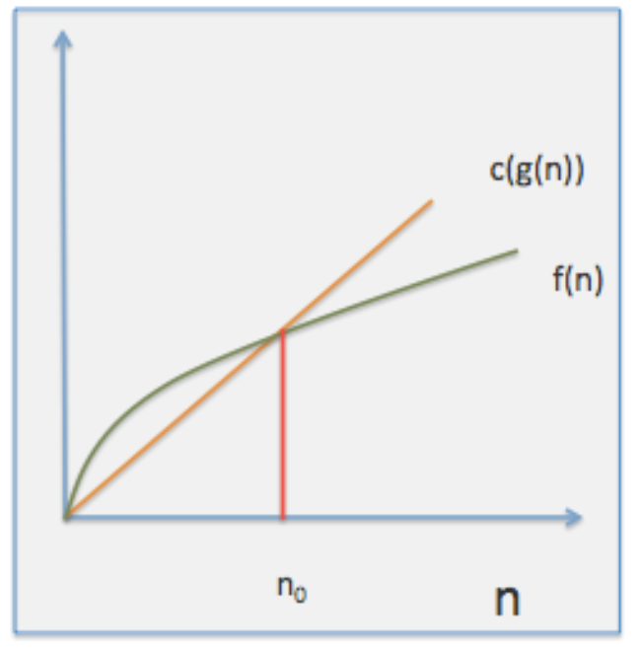
Big Oh Notation : Example (3)
Decision problem: A problem with a yes or no answer.

Slide 16
NP, NP Complete and NP Hard (1)
P : P is a complexity class that represents the set of all decision problems that can be solved in polynomial time.
Example
Given a connected graph G, can its vertices be coloured using two colours so that no edge is monochromatic?
Algorithm: start with an arbitrary vertex, color it red and all of its neighbours blue and continue. Stop when you run out of vertices or you are forced to make an edge have both of its endpoints be the same color.

Slide 17
NP, NP Complete and NP Hard (2)
NP:
NP is a complexity class that represents the set of all decision problems for which the instances where the answer is "yes" have proofs that can be verified in polynomial time.
NP-Complete:
NP-Complete is a complexity class which represents the set of all problems X in NP for which it is possible to reduce any other NP problem Y to X in polynomial time.
NP-hard:
Intuitively, these are the problems that are at least as hard as the NP-complete problems. Note that NP-hard problems do not have to be in NP, and they do not have to be decision problems.
Notes:
Example of NP:
Integer factorisation is in NP. This is the problem that given integers n and m, is there an integer f with 1 < f < m, such that f divides n (f is a small factor of n)?
This is a decision problem because the answers are yes or no. If someone hands us an instance of the problem (so they hand us integers n and m) and an integer f with 1 < f < m, and claim that f is a factor of n (the certificate), we can check the answer in polynomial time by performing the division n / f.

Slide 18
Learning Outcomes with the Topic
Understanding the need of Time and Space Complexity in Search Algorithms

Slide 19
Methodology And Assessment Criterias
Class Assignment(s)
Each chapter being covered will have one assignment. The Case Studies will be given in line to the Changing with Speed across IT Projects in Kirirom
Internal Exam(s)
There will be 2 exams
Model Exam
There will be one Model Exam.
Semester Exam
There will be 1 Semester Exam

Slide 20
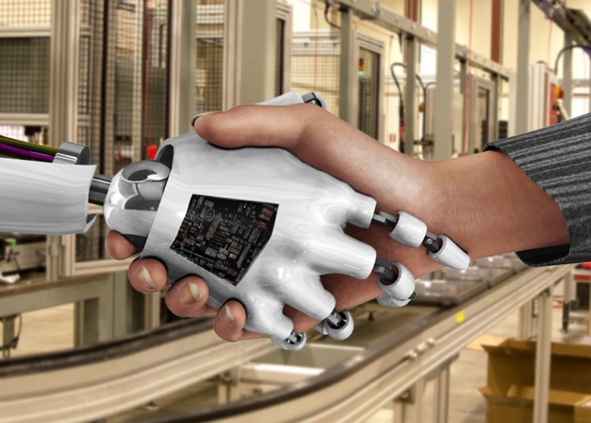
Thank You !
“An Algorithm Must Be Seen to Be Believed”
- Donald Knuth

